Slide 1

CRUD with Xamarin Forms and EF Core
Bon Macalindong, Senior Developer @ XAM Consulting

Slide 2
Agenda
What is EF Core
EF Core, core concepts
DbContext
DbSet
Providers
Configuration
Demo
Resources

Slide 3
What is EF Core?

Slide 4
What is EF Core?
A lightweight, open source and cross platform object-relational mapper (ORM). It enable developers to interact with the database using .NET objects instead of dealing with data-access code that developers need to write when using the traditional approach.

Slide 5
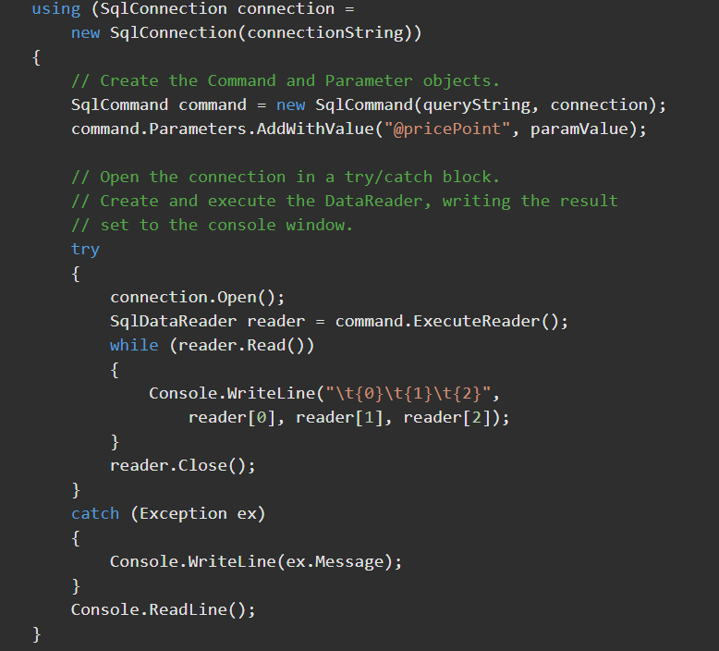
What is EF Core?
Traditional data access
Sample code to connect to a SQL Server database using ADO.NET

Slide 6
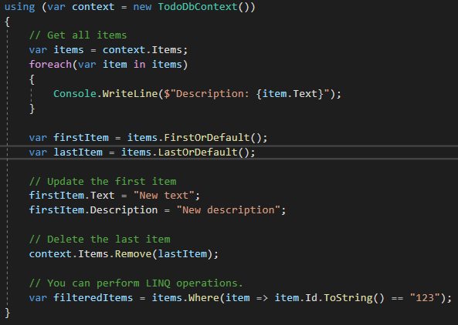
What is EF Core?
ORM
Sample code using EF Core.

Slide 7
EF Core, core concepts

Slide 8
EF Core, core concepts
DbContext
A class that holds a session and provides an API to communicate with the database.
DbSet
A class to represent your entity collections and is the gateway to perform database operations such as create, read, update, delete.

Slide 9
EF Core, core concepts
Providers
Plugins that enables you to connect to a particular database technology.
e.g. SQL Server, SQLite, MySQL, etc.
Configurations
EF core provides overridable methods where developers can configure the connection and schema of the database.

Slide 10
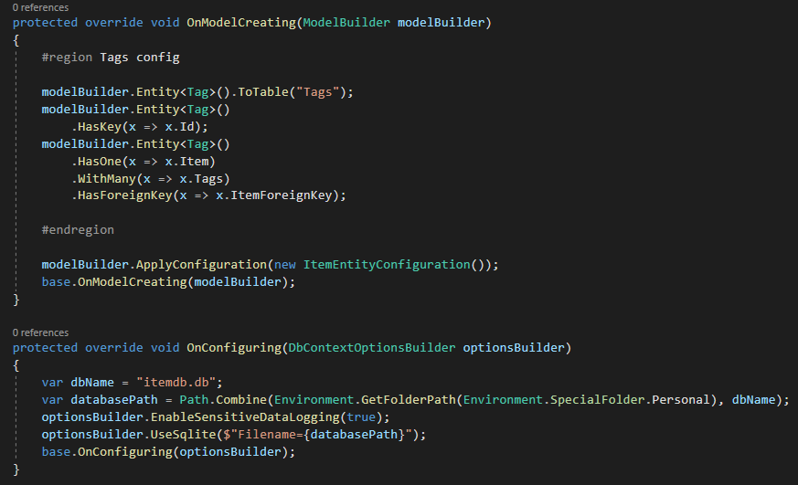
EF Core, core concepts
EF Core for SQLite setup

Slide 11
Resources
https://docs.microsoft.com/en-us/ef/core/
https://www.entityframeworktutorial.net/efcore/entity-framework-core.aspx
https://www.learnentityframeworkcore.com/
https://medium.com/@yostane/data-persistence-in-xamarin-using-entity-framework-core-e3a58bdee9d1

Slide 12
Demo

Slide 13
Thank you!
Shoot your Questions!
Bon Macalindong, Senior Developer @ XAM Consulting

